Slide 1
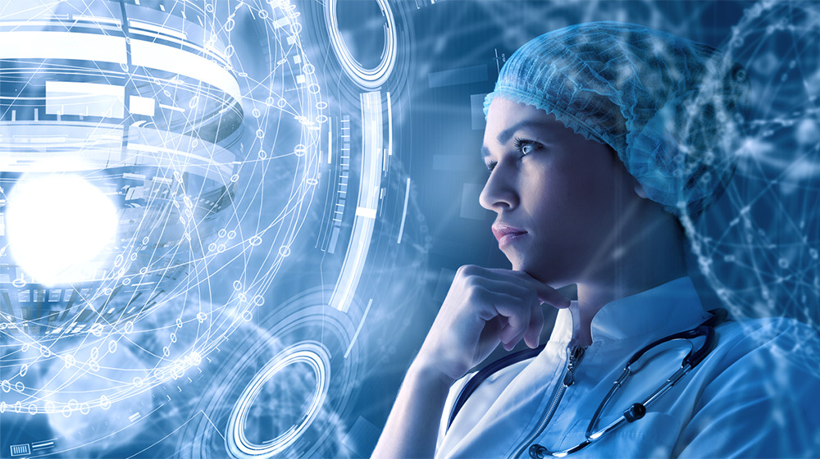
AI in healthcare
Contributor: (Dev_AI)
Navarun Das
Subhasish Chakraborty
Manish Upadhyaya

Slide 2

TABLE OF CONTENTS
Overview of the problem
Why use Machine learning
Problems Faced by people
Technologies used
Pictorial representation
Machine Learning working and implementation
Node.js in a nutshell
Our Services

Slide 3
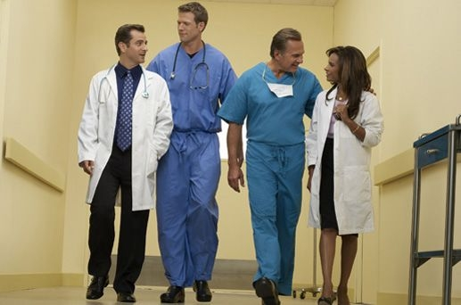
OVERVIEW OF THE PROBLEM
Introduction:
In a country like India with a massive population of about 1.3 billion people there are a numerous challenges that people face in their day to day life and unsurprisingly healthcare is one of those major challenges which needs to be dealt with at the earliest. Over the past few decades scientists have come up with numerous inventions in the field of healthcare which could cure several diseases at a low cost and doctors being proficient in their field in a way that had never been witnessed before. Advances in latest medicine over the past few decades have improved healthcare immensely allowing doctors to more efficiently diagnose and treat diseases but doctors are still humans which means they understandably still make mistakes .
Diagnostic mysteries and unnecessary deaths in hospitals would drastically decrease if doctors had the accuracy as that of a machine learning algorithm. The biggest difference doctors and machines is not their level of intelligence but how they approach patient problems and the type of health systems that supports them. This combination is what causes such wide variations in clinical outcomes and it’s the reason why machine learning is the best solution out there.
y are humans

Slide 4
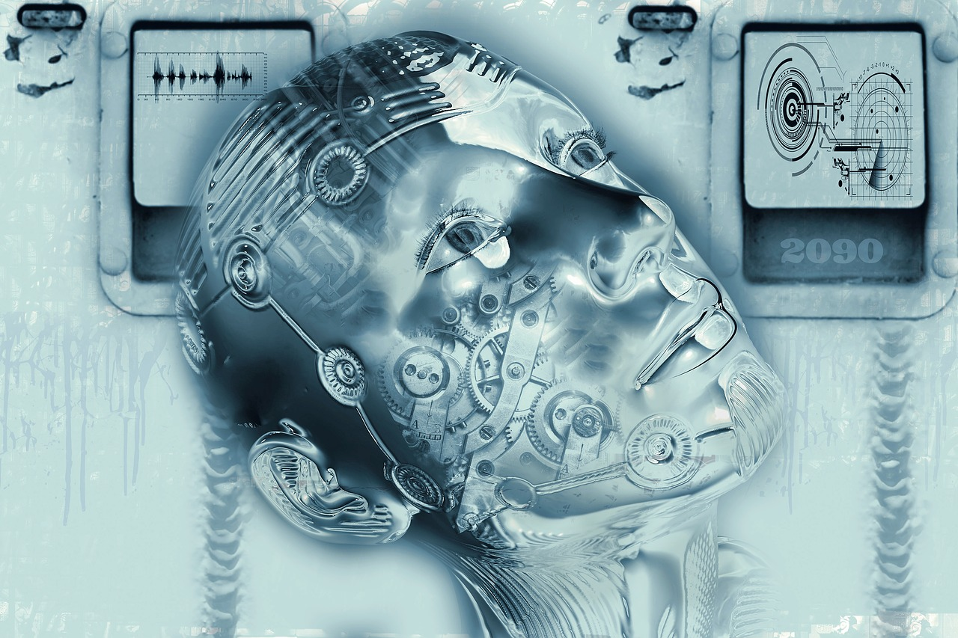
Why use Machine learning
Machine learning provides a cost effective way to diagnose cancer very accurately. It is also a much more accurate and easily available option to a large number of people. Plus it is a robust and uses state of the art algorithms such as K Nearest Neighbours, Decision trees, Logistic Regression etc to solve various problems in day to day life.
Moreover, there is a acute shortage of expert radiologist who can predict cancer with such high accuracy as that of a trained machine learning algorithm, which has been perhaps trained on billions of dataset. Integrating such state of the art algorithm with a website makes it easier for common people to access such facilities at much ease and with negligible cost.

Slide 5
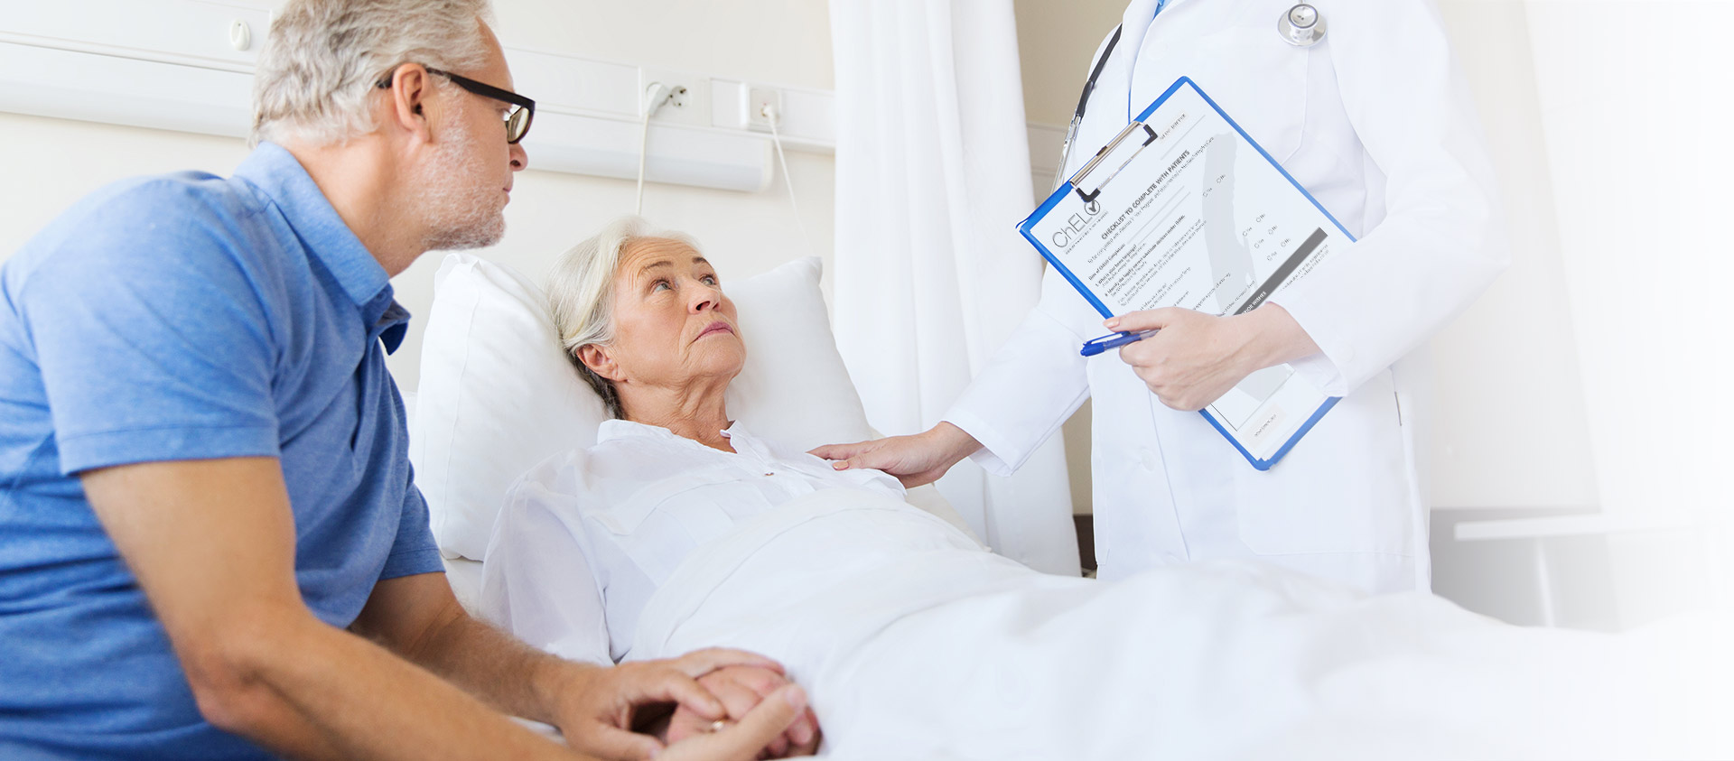
Problems faced by people
How Much Does It Cost?
The financial burden of battling cancer can be overwhelming, and patients need to be aware of expenses associated with managing the disease. Costs will vary based on a number of factors unique to each patient.
Surgery
Surgery can cost lakhs of rupees. Because asbestos-related cancer is rare, the precise costs of related surgery cannot be determined. Lung cancer surgery, which is comparable to pleural cancer surgery because of the area being operated on, has an average surgery cost of 20 lakhs.
Chemotherapy
The costs for chemotherapy can vary as well, with some estimates as high as 15 lakhs over an eight-week period. The average cost for an initial treatment is approximately 5 lakhs. Expenses differ depending on the drugs, the stage of the cancer and other factors specific to each patient.
Radiation
Radiation treatment can also have high costs because sophisticated equipment and machinery is used. The total expense depends on the number of treatments, the type of radiation and the patient’s health coverage. Some estimates place the patient cost for radiation therapy at around 1.5 lakhs a month.
Alternative Therapies
In addition to conventional medical treatments, alternative therapies such as acupuncture, chiropractic care and massage may also provide relief. These therapies, which can relieve pain, fatigue and other symptoms, may not be covered by health insurance.

Slide 6
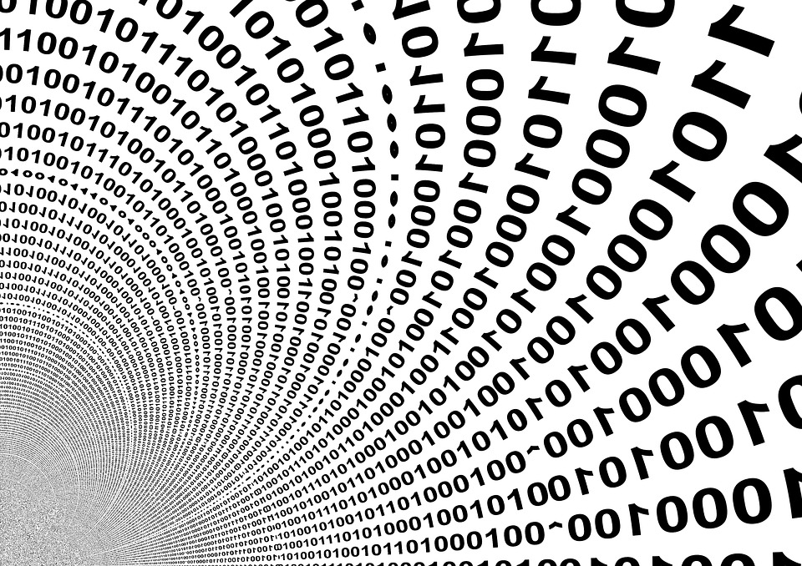
Technologies used
Algorithms used in building the machine learning model for predictions
Logistic Regression
Linear Regression
K Nearest Neighbors(KNN)
Neural Network
Decision trees
Random Forest
Support Vector Machines(SVM)
Technologies used in Website
Node.js
Express
Html, CSS, Javascript

Slide 7

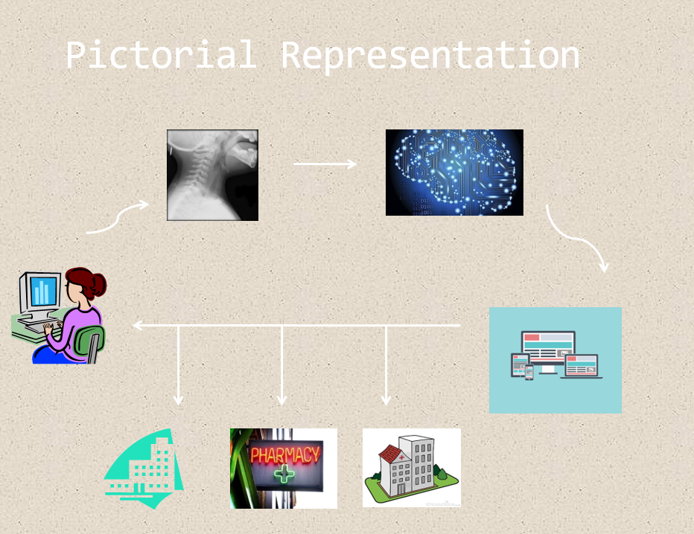
Pictorial Representation

Slide 8

Machine Learning model implementation
In the machine learning model that we implemented ,we used the scikit learn , numpy, pandas and matplotlib libraries. We used the Wisconsin breast cancer dataset from the UCI Machine Learning repository in this project. We implemented various algorithms using these libraries and tested their accuracies separately. We found that the random forest algorithm outperformed the rest of the algorithms in this case.
Given a certain number of features to be fed(user data) into the machine learning model, we were able to classify whether the cancer tumor is malignant or benign .

Slide 9

Website in a nutshell
The Project has two back-ends involving Node.js and Flask.
Using Node.js and Express we have hosted our Website, and used flask to host our Machine learning model api.
Through our Browser’s Geolocation, and Google Maps API, we intoduced Google Places to find different Hospitals

Slide 10

Our services
We provide real time accurate cancer detection using sophisticated machine learning models.
It has been integrated with a interactive web based UI to make it accessible to general masses.
Also, along with prediction we provide information about the nearby cancer hospitals, so that
the user can choose any of the hospitals provided in the result list for further treatment. This
approach towards the problem aims in providing a hassle free solution to the user as much as
possible.

